Slide 1

Introducing the NEW WebEOC Nexus and Juvare Exchange
May, 2024

Slide 2
We Are Doubling Up
You will now have two people assigned to help you make the most of WebEOC:
  Oliver Oetterer- Account Executive
  Lisa Teel- Client Success Manager

Slide 3
About Me – Lisa Teel
Started EM Career in 2001
Specialized in emergency preparedness for education
Client Success Manager at WebEOC since 2022
“Juvare pays my salary but I work for you!”

Slide 4

It’s time for
NEXUS

Slide 5
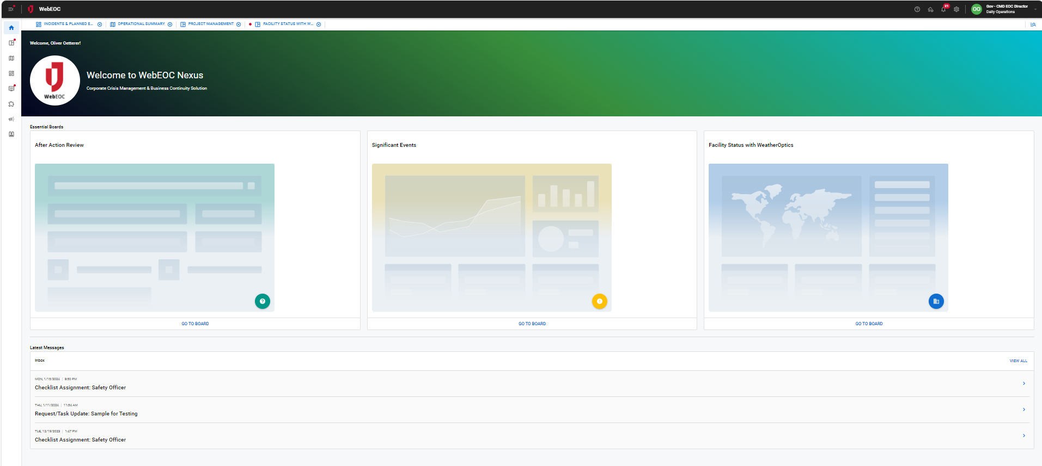
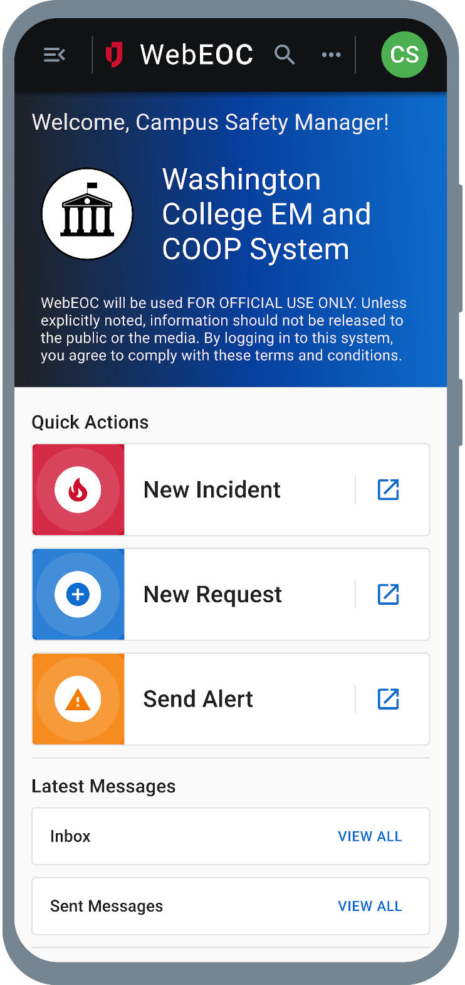
WebEOC Nexus - Designed for Emergency Management
Modern user interface and design
Mobile responsive (mobile app)
Enhanced Mapping (Esri – ArcGIS based)
Multi-channel notifications (ad-hoc and conditional)
Standard workflows for all phases of EM (off-the-shelf and customizable)
No-code/low-code workflow, form, and dashboard builder (DesignStudio)
Seamless integration via APIs and JX Connectors
Collaboration through Juvare Exchange
Customizable Home screens

Slide 6
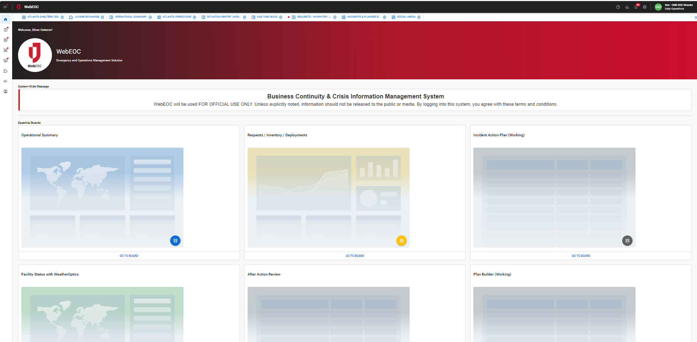
Position Specific Home Screen
Most frequently used processes on Home Screen
Up to 15 Pinned Boards
Easy to configure by position (no coding)

Slide 7
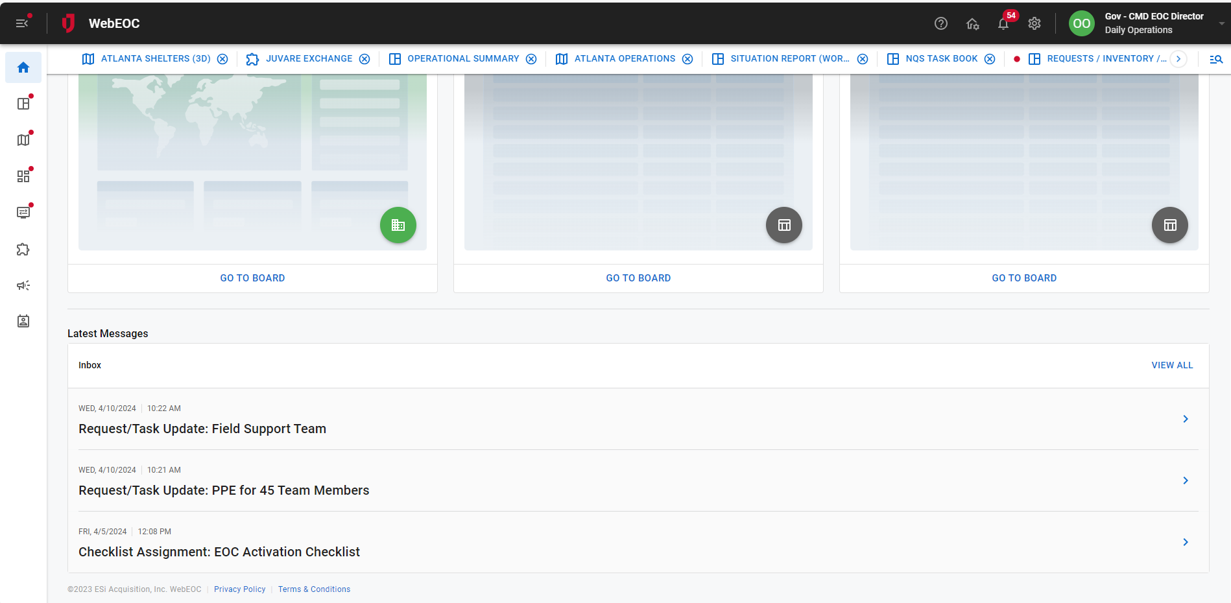
Latest FYI or To Do Messages on Home Screen

Slide 8
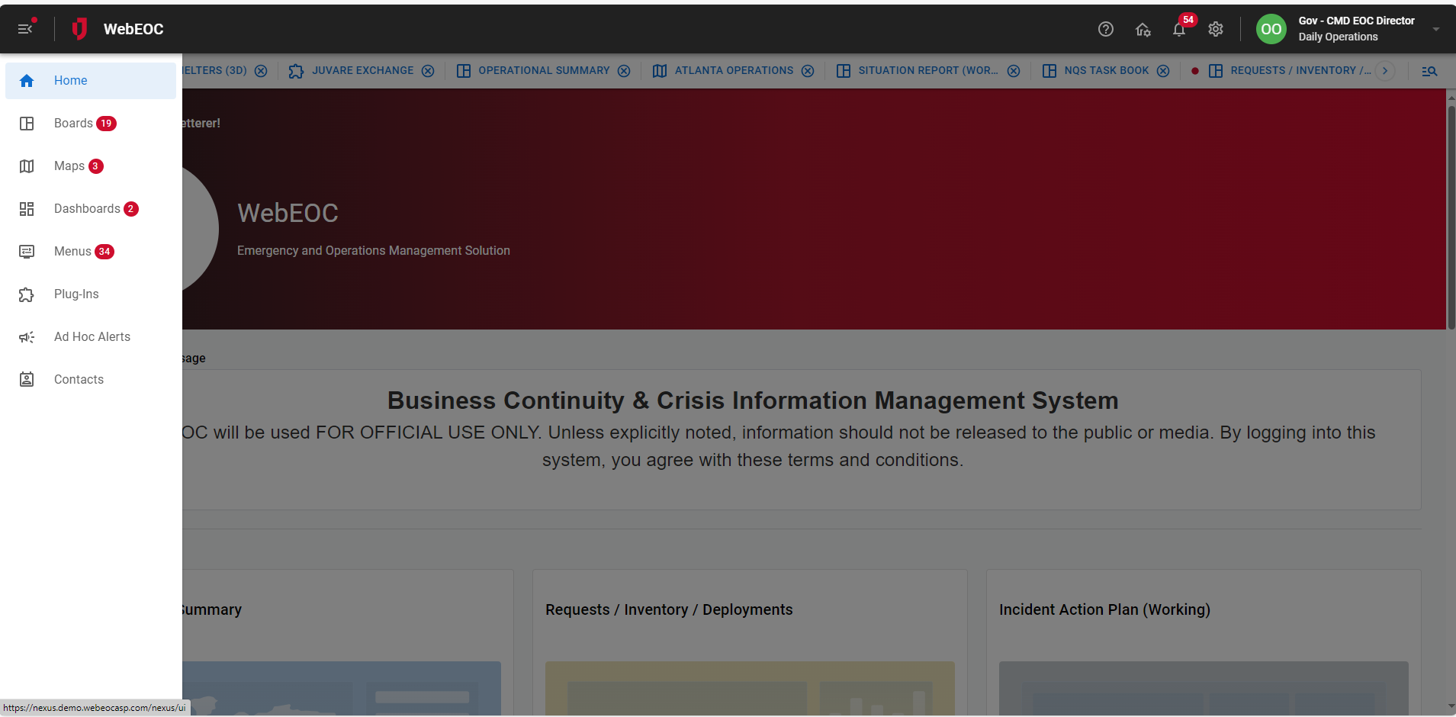
Updated WebEOC Menu
Menu is divided into sections
Prominent indicator when new data is present
Easily toggle menu on/off for more screen real estate

Slide 9
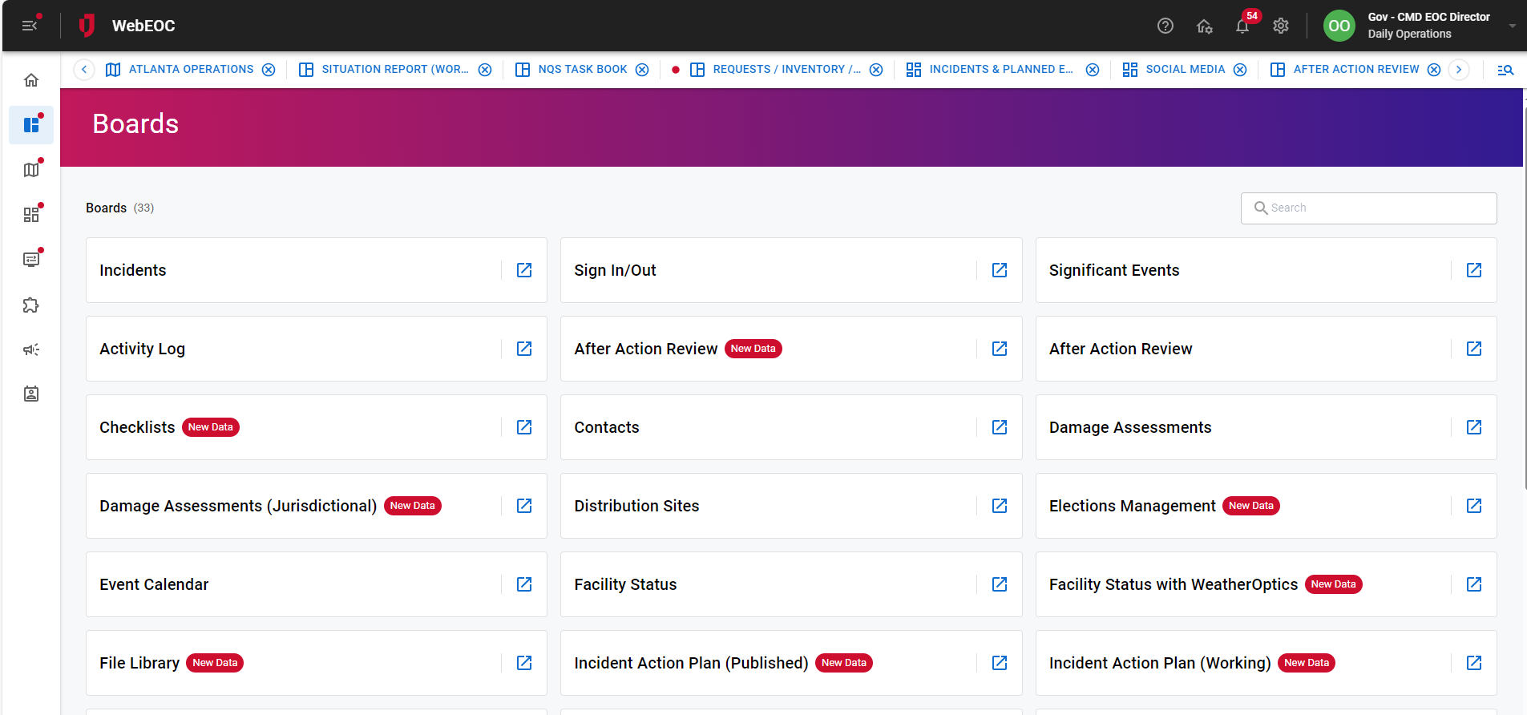
Menus
Menu details are now in tile view
Prominent indicator when new data is present

Slide 10
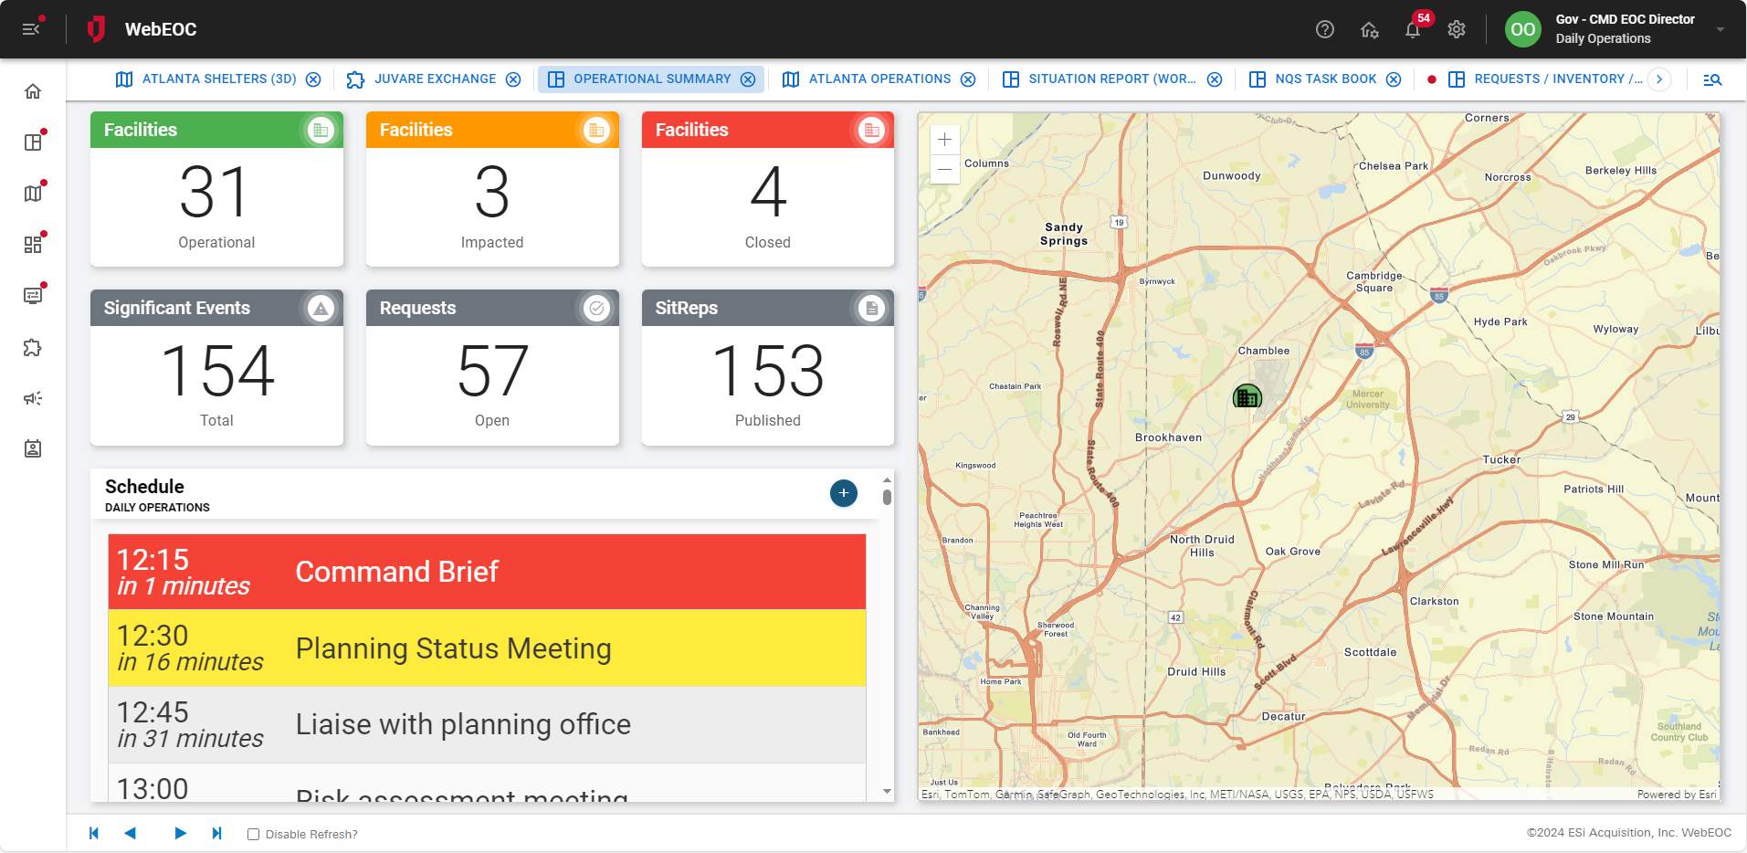
Dashboard Manager for pulling multiple board data into one Dashboard

Slide 11
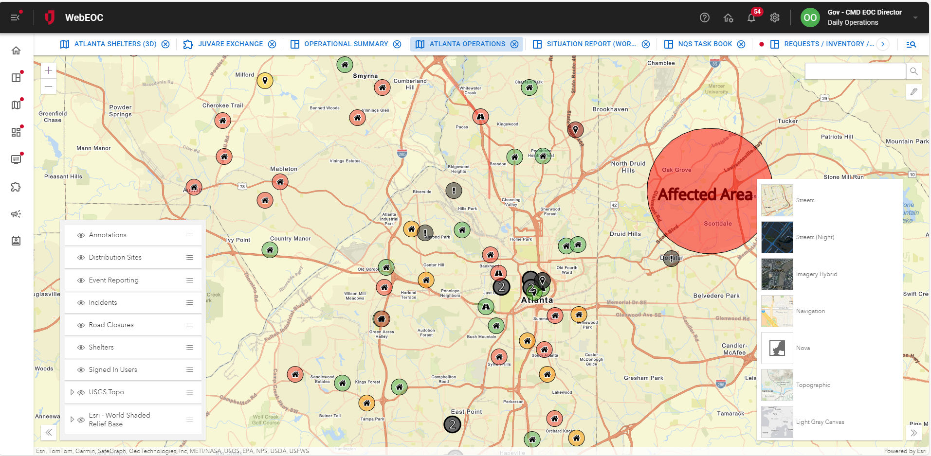
Enhanced Mapping
Multiple Base layers
Annotations
Pull in multiple board datasets into one map
Turn layers on and off
Pull in 3rd Party Data Sources (weather, hurricanes, etc.)

Slide 12
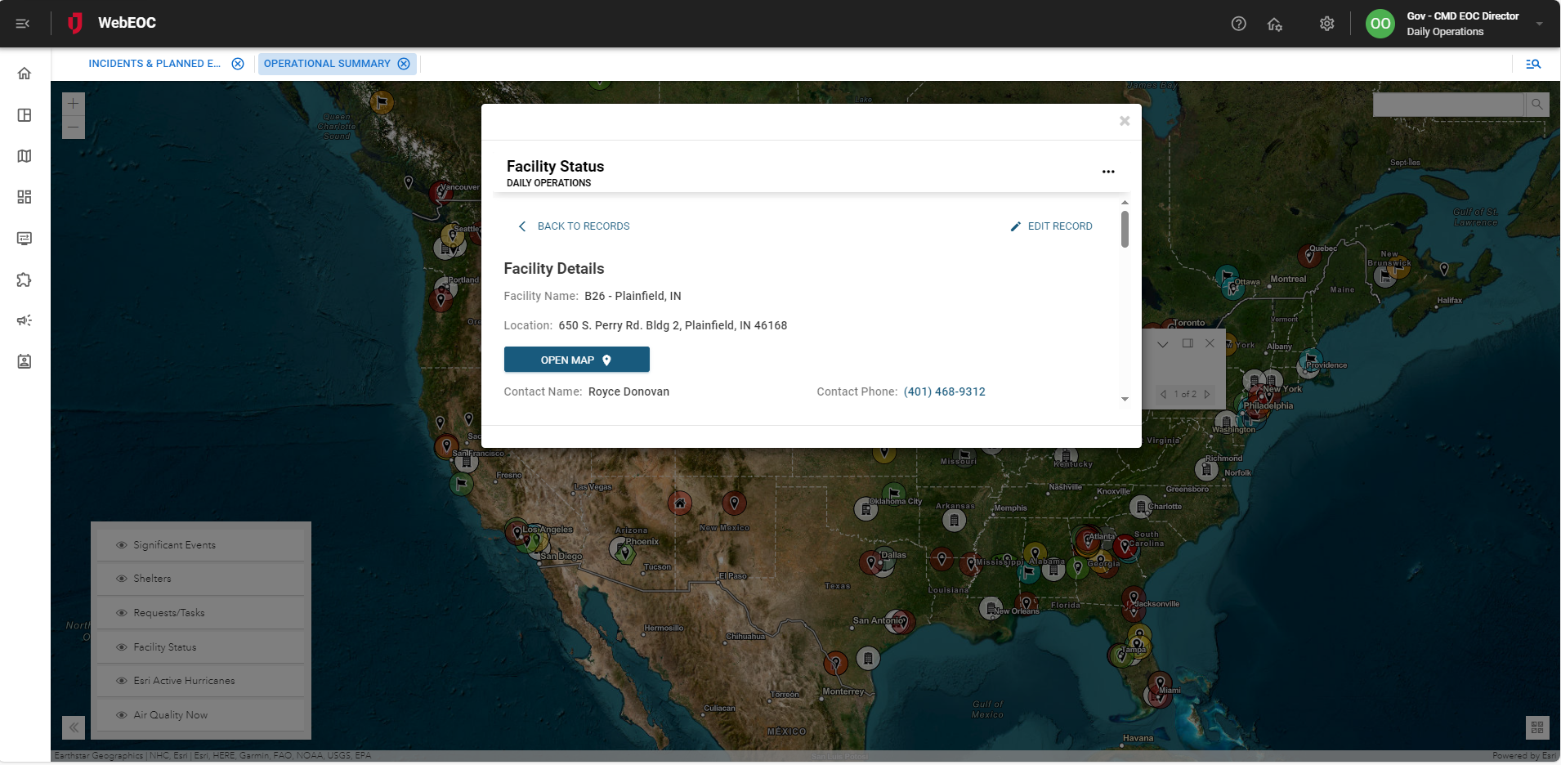
Maps- Edit Records Directly in Map View

Slide 13




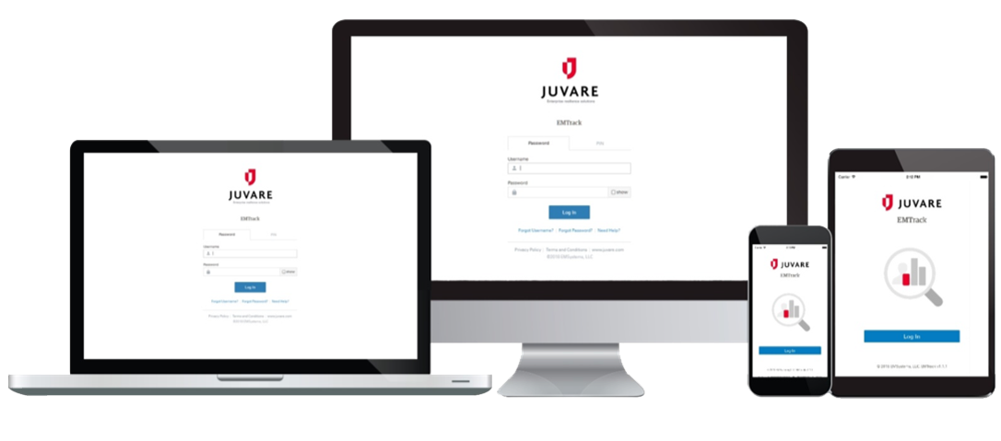
Emergency Management Boards
After Action Review/Improvement Plan
Checklists
Contacts
COOP Plan Builder
Contact Tracing
Damage Assessment
Distribution Sites
Plan Builder
Event Calendar
Event Reporting
Facility Status
File Library
Incident Creator
Incident Action Plan (IAP) Builder
Incident Documentation
National Qualifications System (NQS)
Personnel Staffing
Project Management
Request Tasks
Requests, Inventory & Deployments
Road Closures
Schedule/Battle Rhythm
Shelters
Sign In/Out
Situation Report Builder
13
Notes:
Clean up order

Slide 14
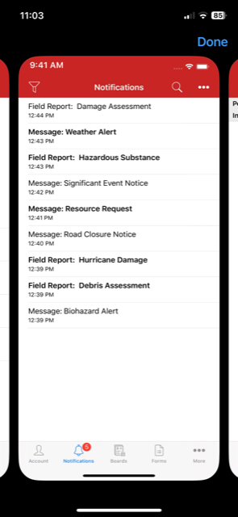
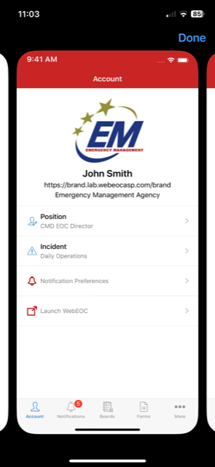
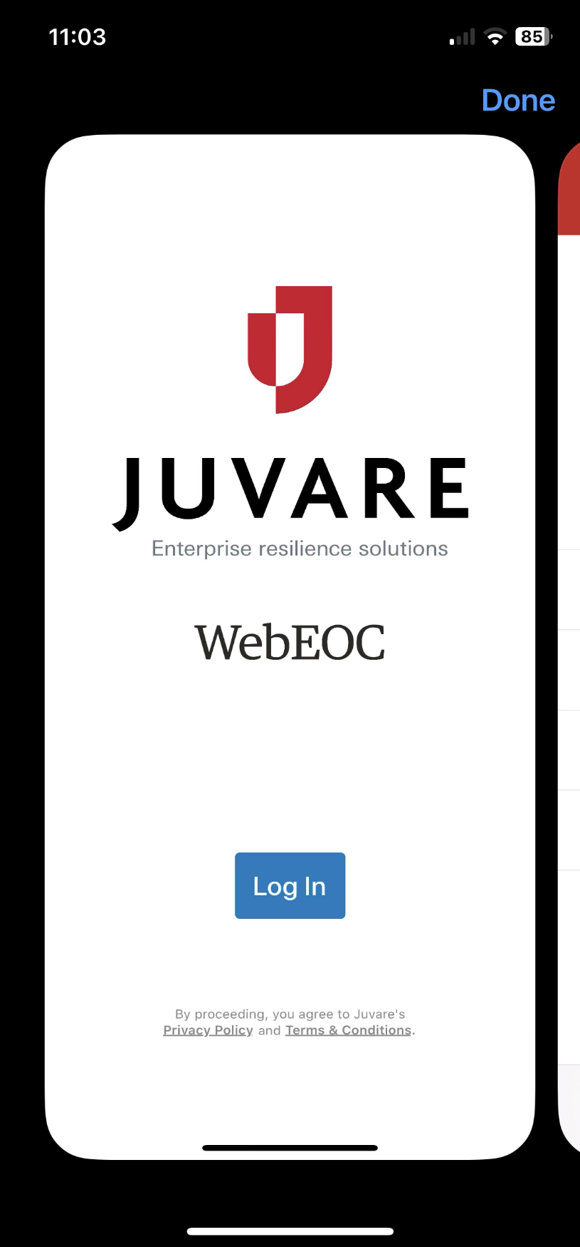
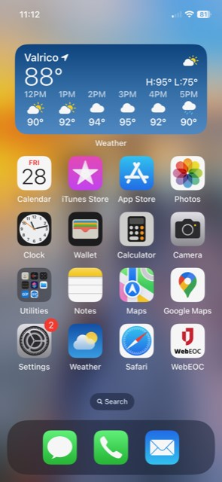
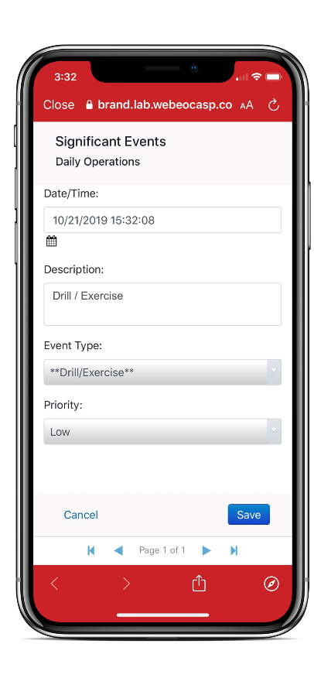
WebEOC Mobile Application
Available for Android & iOS
Touch / face authentication for faster login
Modern UI and design
Increase productivity in the field
View notifications and assignments
Complete forms offline & upload later
View and edit mobile-friendly board views

Slide 15
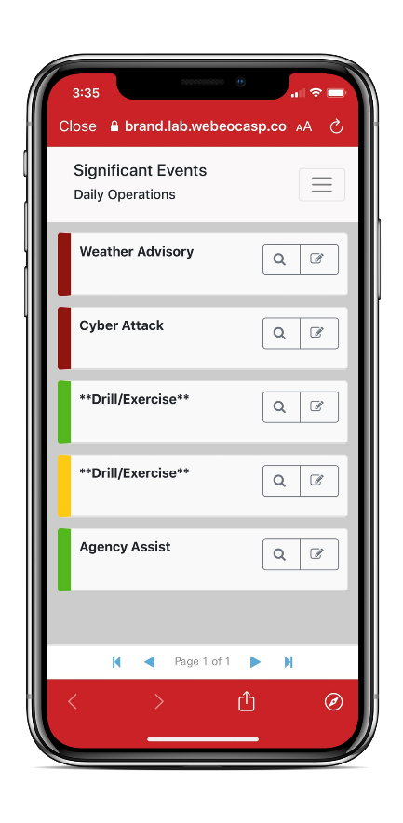
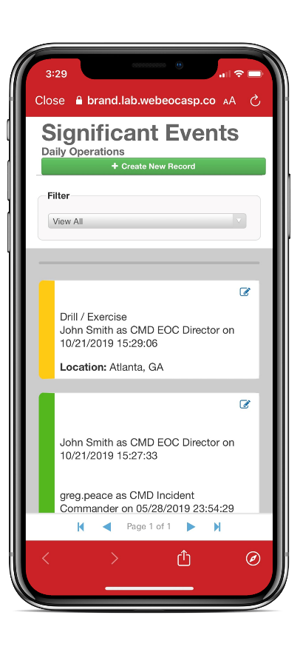
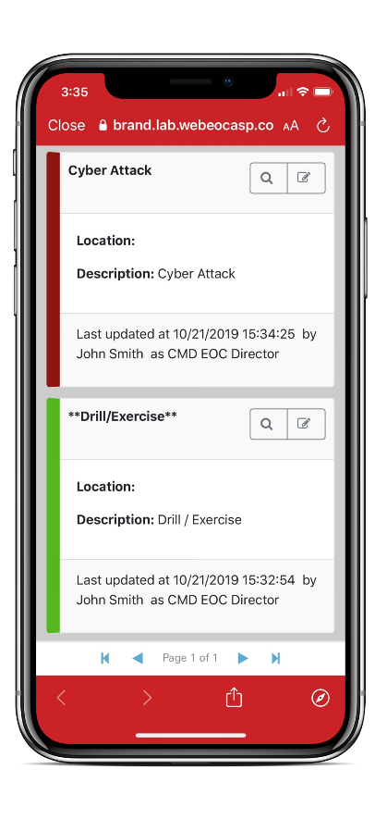
WebEOC Mobile Board Examples
WebEOC Mobile
  Simple
  Functions On or Offline
  Always Connected

Slide 16
WebEOC Alerting

Slide 17


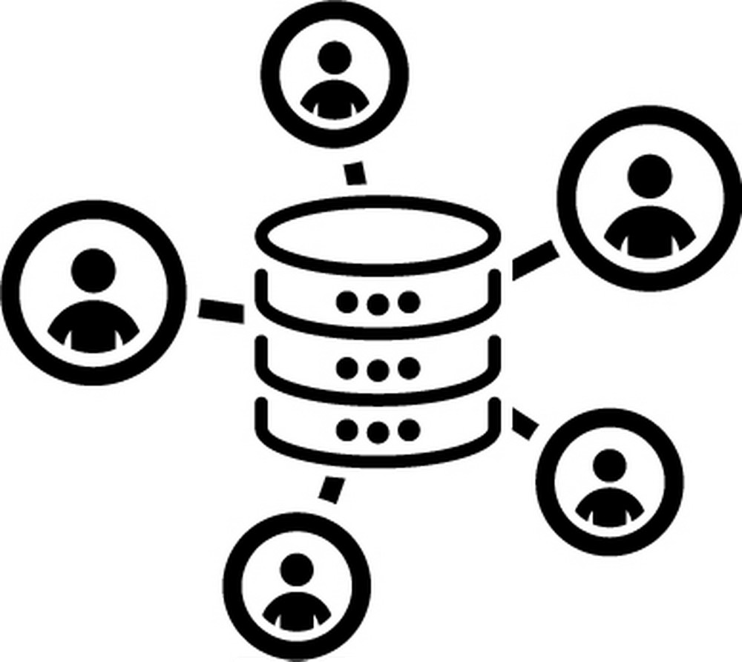
Alerting with WebEOC Alerts
Intelligent Workflows
Make it a Feature
Scalable Engagement
Link discrete actions based on conditional logic, to create efficiency & engaging experiences.
Use alerting everywhere it makes sense, in ways integral to operations, and as a force multiplier.
From highly tactical to broad and strategic messaging – an audience of 1, or 100,000+

Slide 18
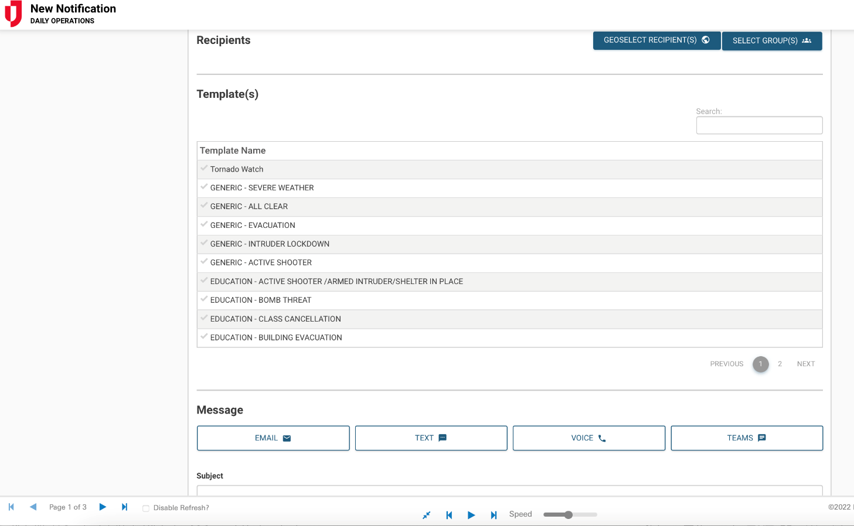
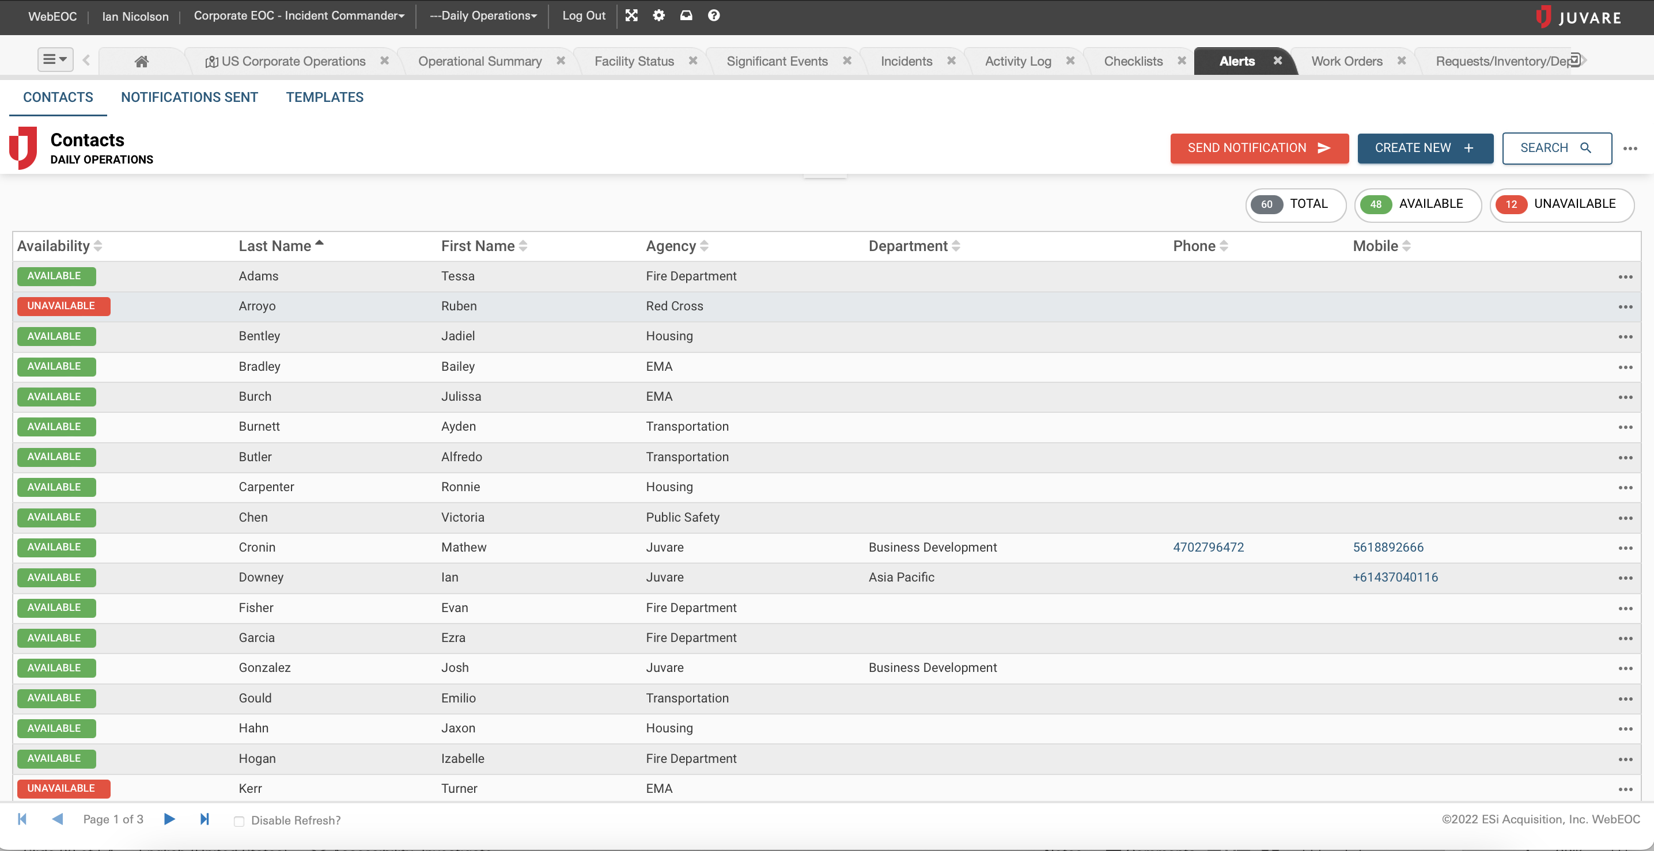
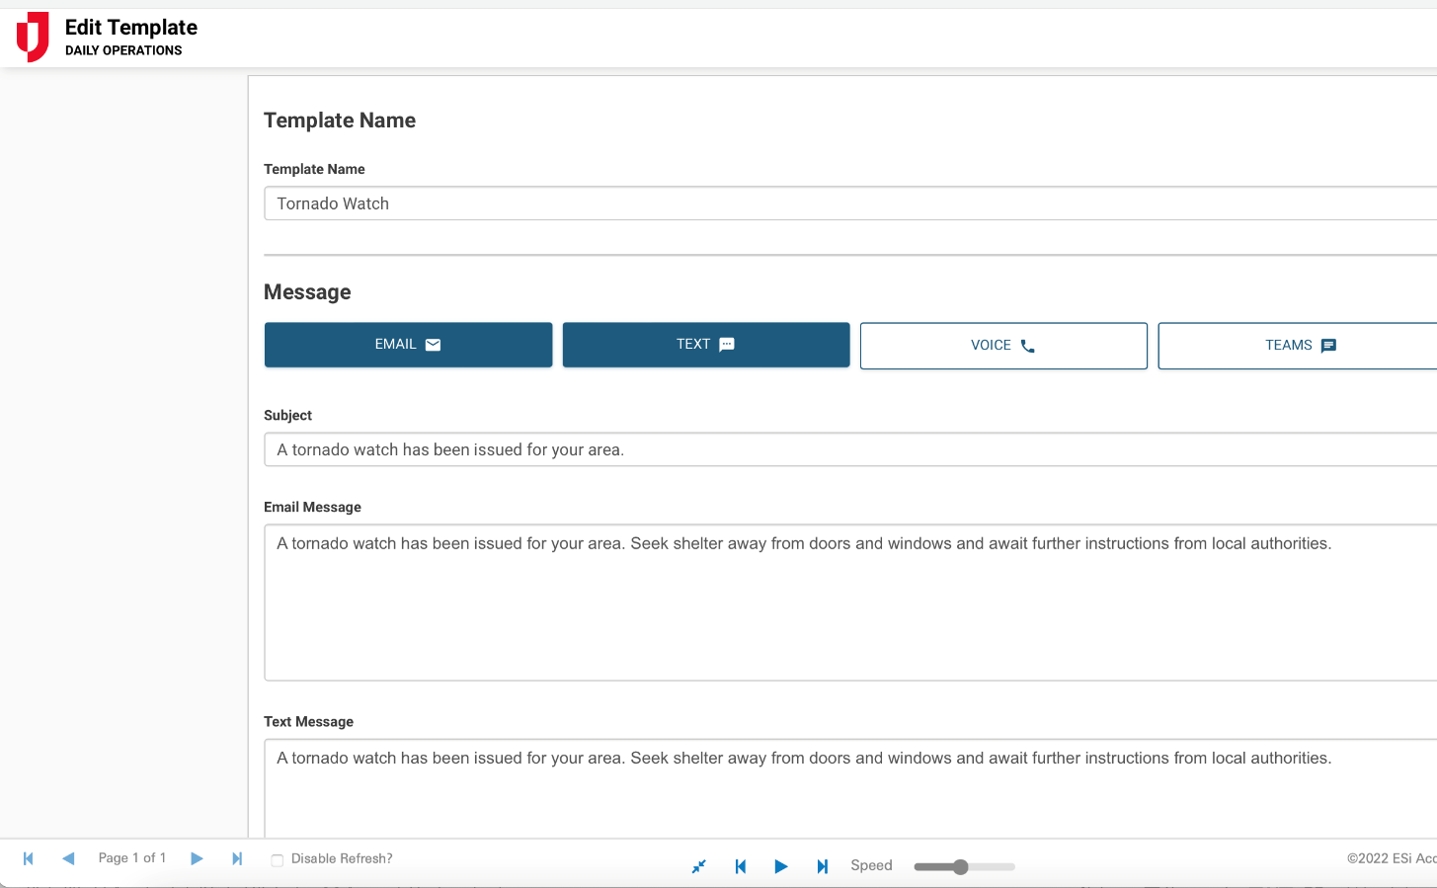
Alerts/ Notifications
Automate and/or schedule notifications to any number of modes including SMS text, voice, MS teams, Slack, WhatsApp, etc.

Slide 19
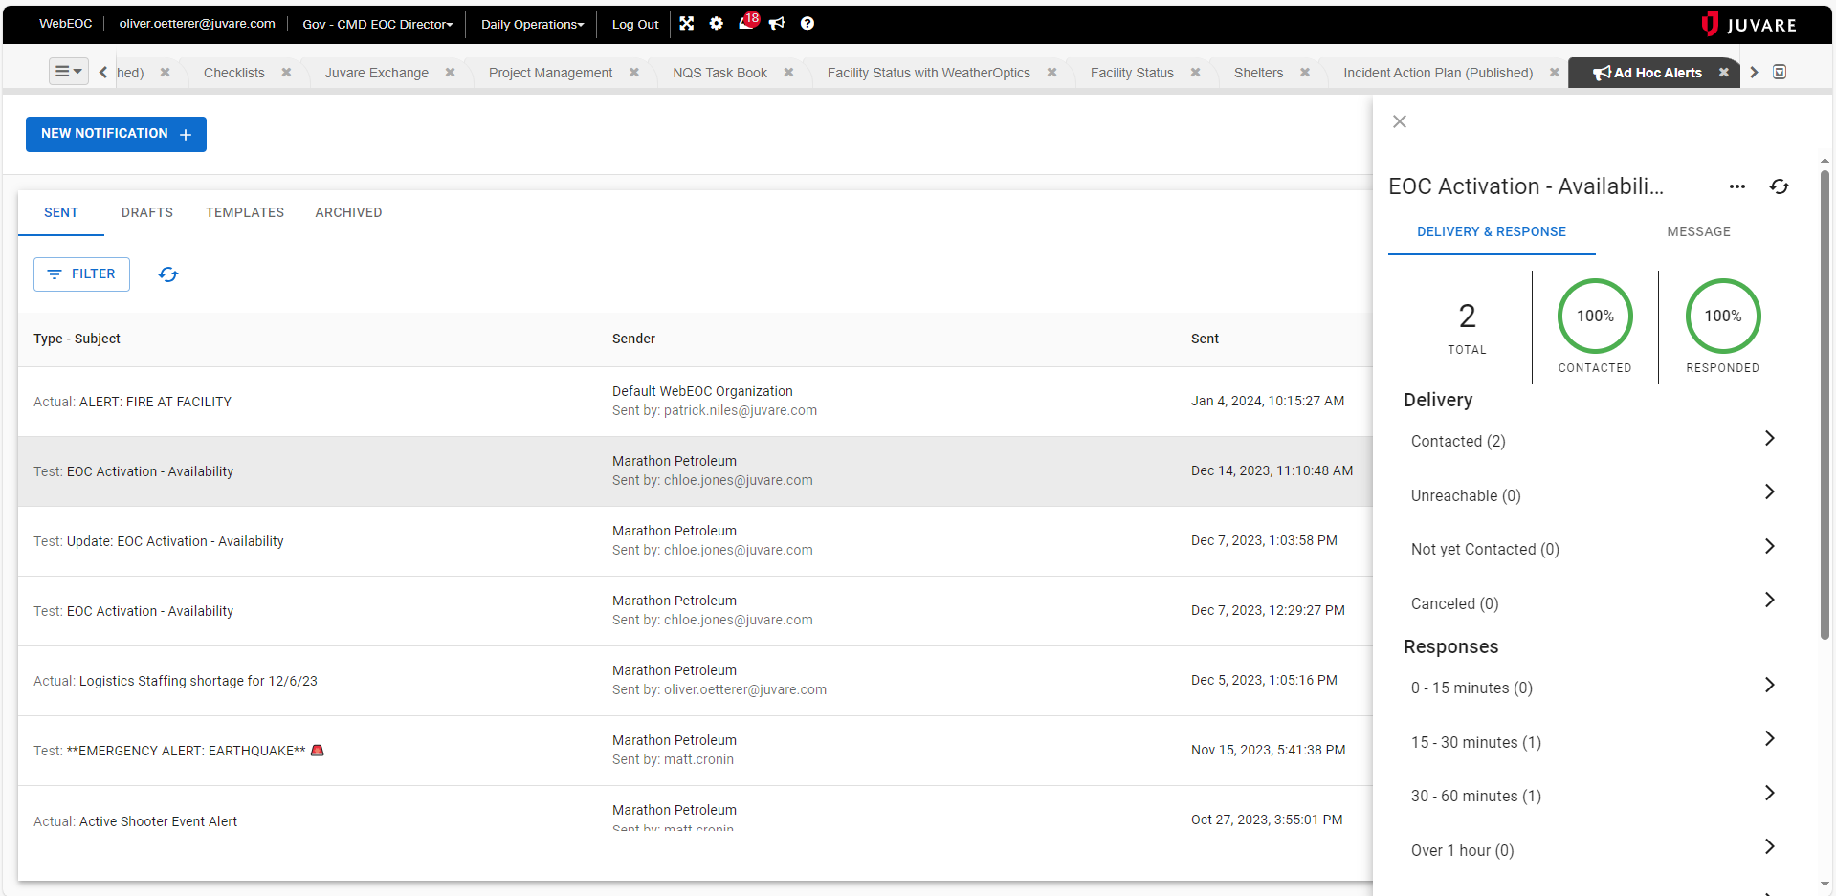
WebEOC Ad Hoc and Board Alerting

Slide 20
DesignStudio Pro

Slide 21

DesignStudio Pro
DesignStudio Pro help collect information from the public, community partners and internal stakeholders by creating public landing page forms. These forms feed directly into WebEOC boards.
  The What-You-See-Is-What-You-Get (WYSIWYG) editor and drag-and drop functionality for no-code/low-code form building and publishing.
  Embed forms on your website or share via email or text for barrier-free data collection that can automatically triggers alerts, initiates critical workflows and updates the common operating picture.
Uses cases are endless, however, here are some that have been extremely popular; incident reports, health check-ins, resource requests, and damage assessments.

Slide 22
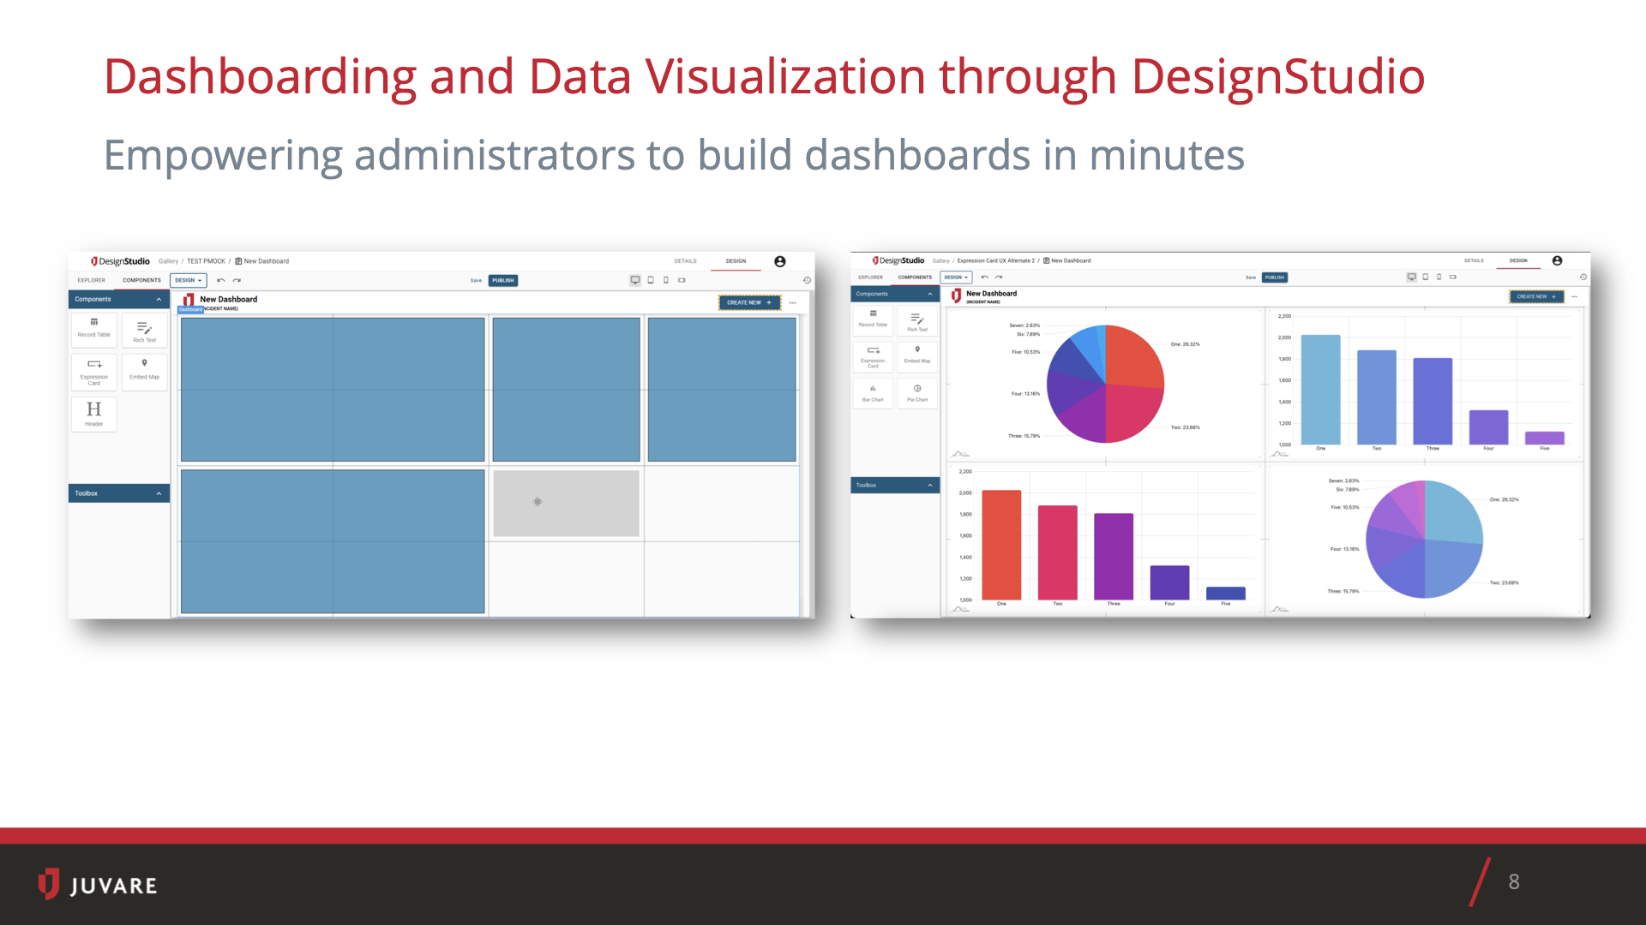
Build & Customize Dashboards
Develop processes flows and/or modify existing ones, in minutes, with Low Code/No Code tools and drag-and-drop process workflows
Notes:
2 screenshots

Slide 23
Juvare Exchange
How JX has made collaboration and integrations easier than ever
23

Slide 24
Juvare Exchange
How can I easily and efficiently collaborate with other Juvare clients?
JX Collaborate / Chat
How can I collect and centralize more critical data to create a common operating picture?
JX Connect / Connectors
How can I gain better insights to drive data-informed decisions?
JX Analyze
What is it, and how it is helping our clients solve complex problems?
Juvare Exchange is a Scalable Data Interoperability and Common Operating Picture Platform

Slide 25
JX Collaborate
How JX has made it easier than ever to collaborate with other clients

Slide 26
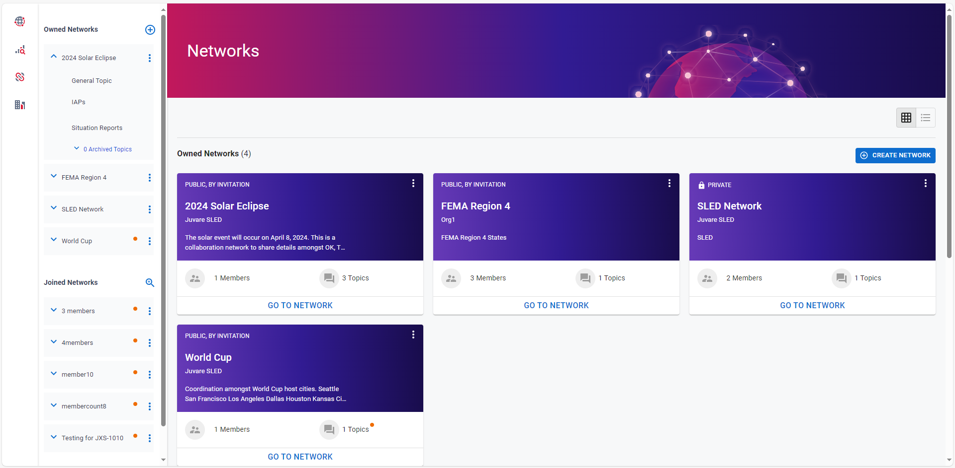
Juvare Exchange - Networks

Slide 27
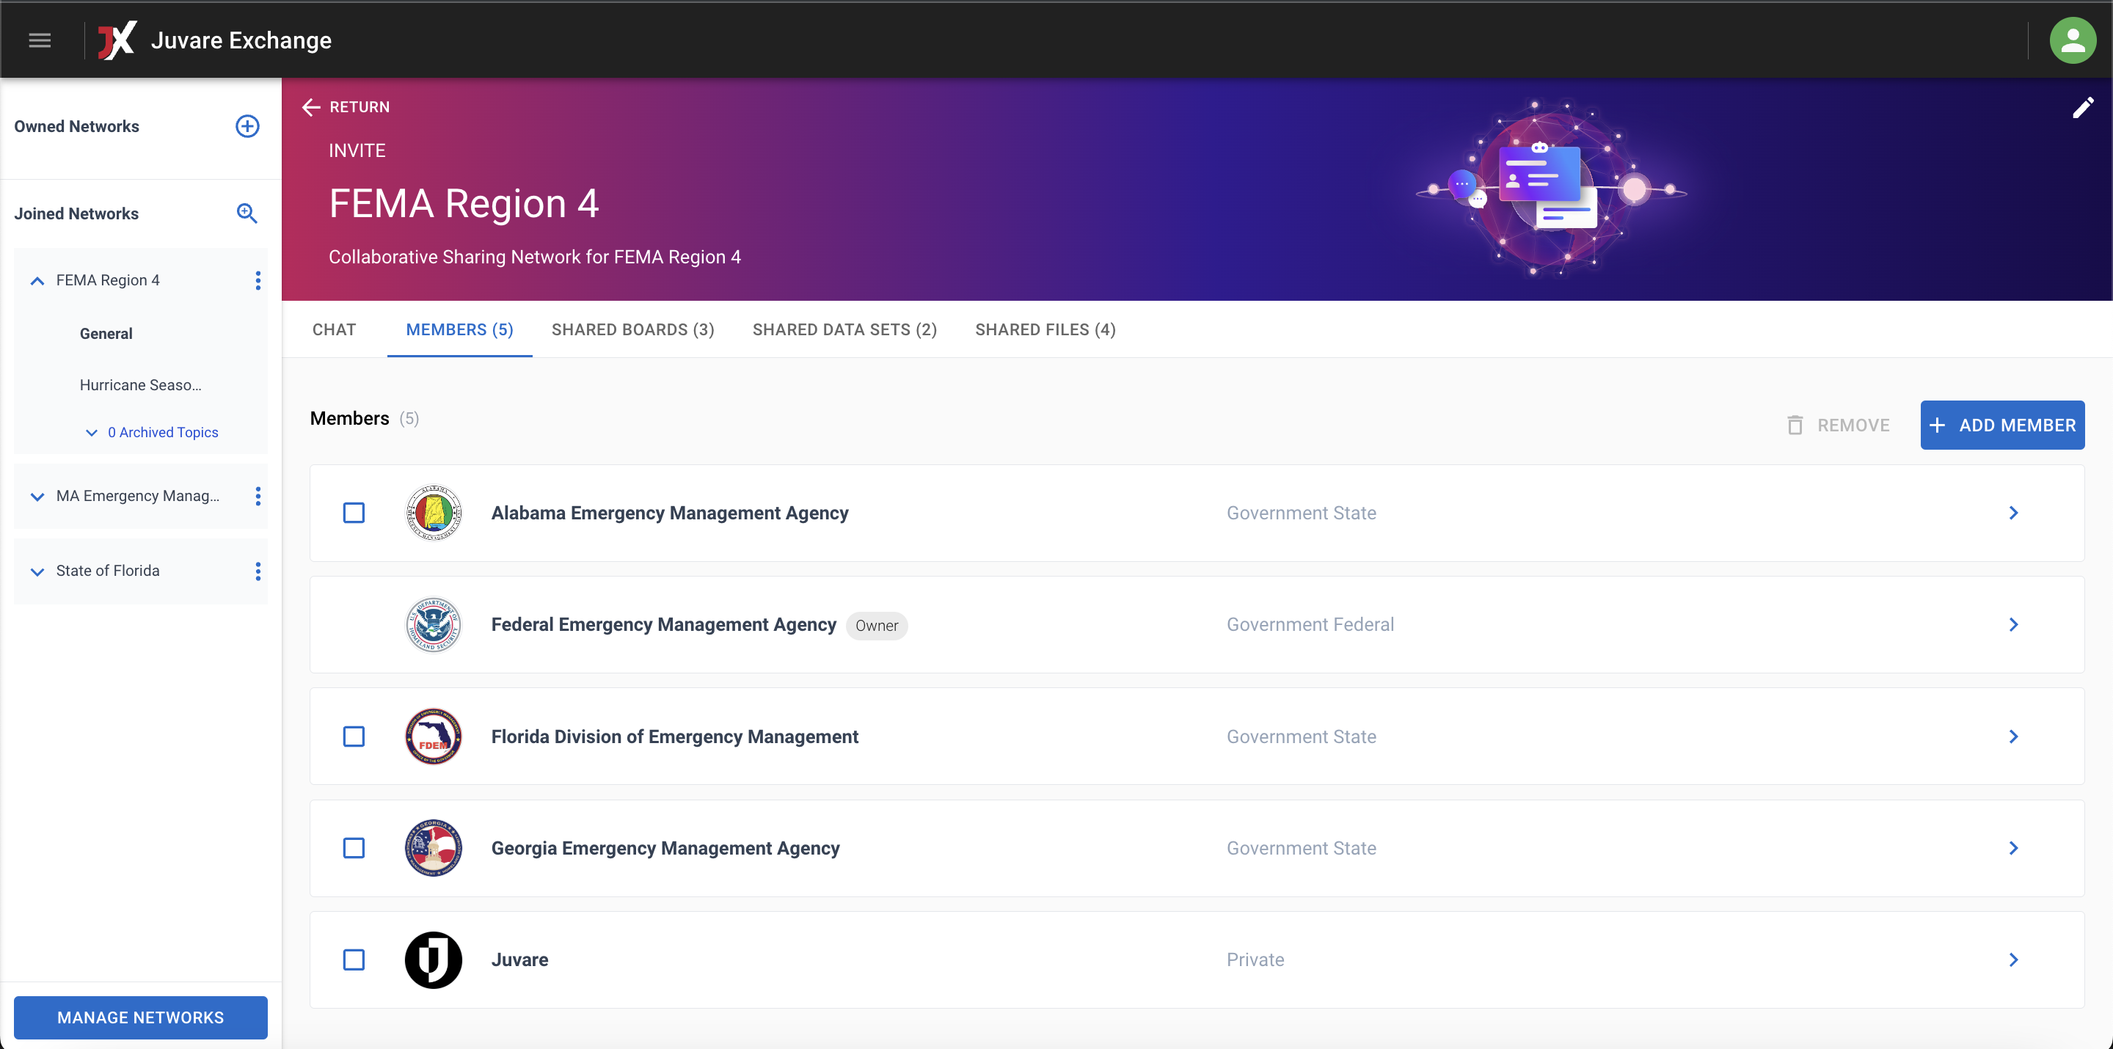
JX Networks
Redesigned for easy, intuitive creation of networks amongst Juvare clients.

Slide 28
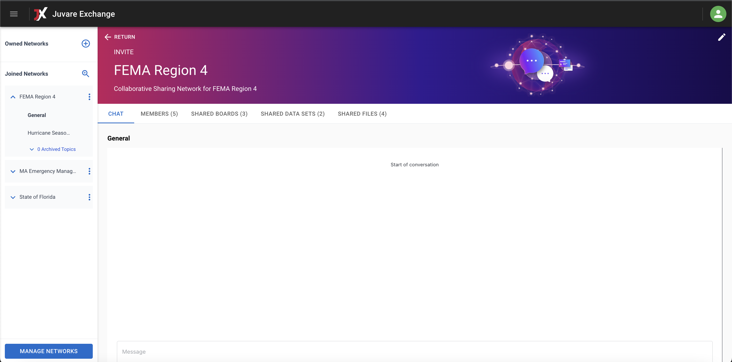
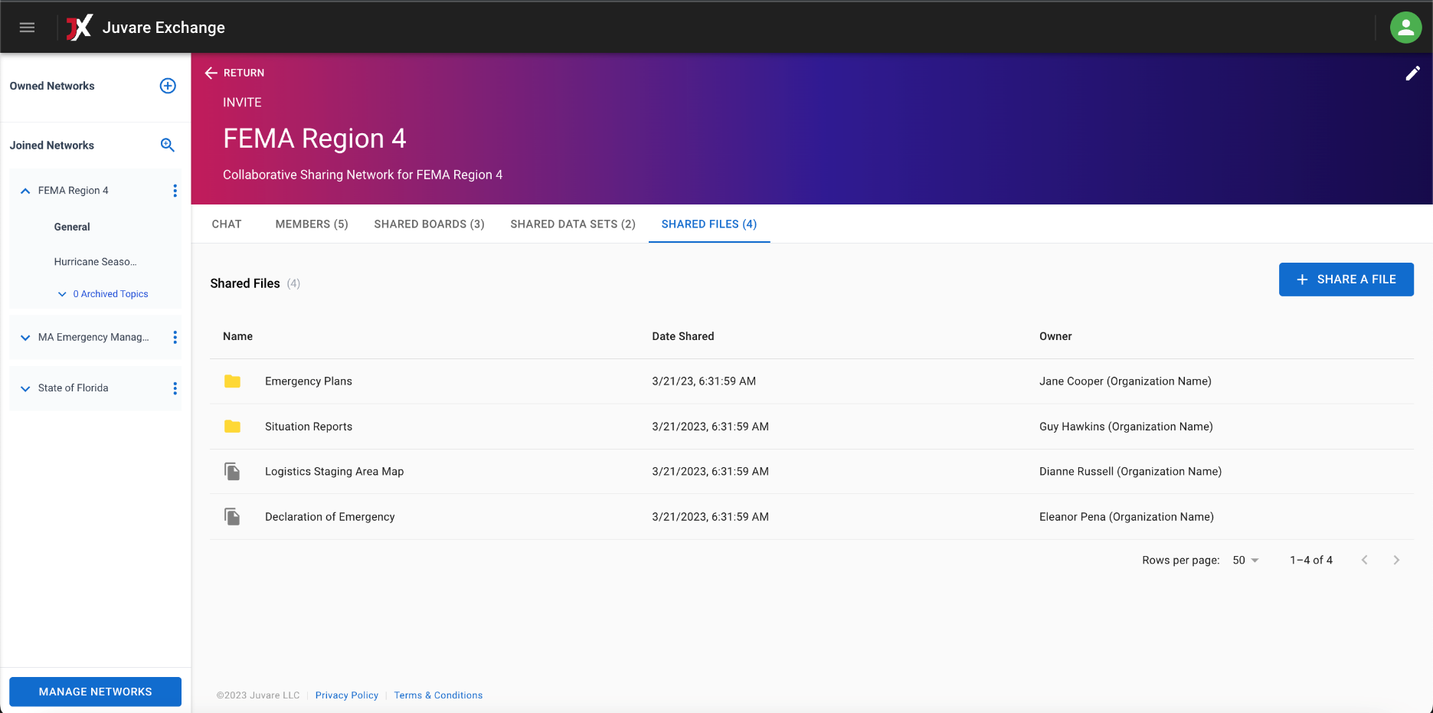
JX Chat & File Share
Supports informal collaboration to maintain the flexibility organizations need.
JX Chat
JX File Share

Slide 29
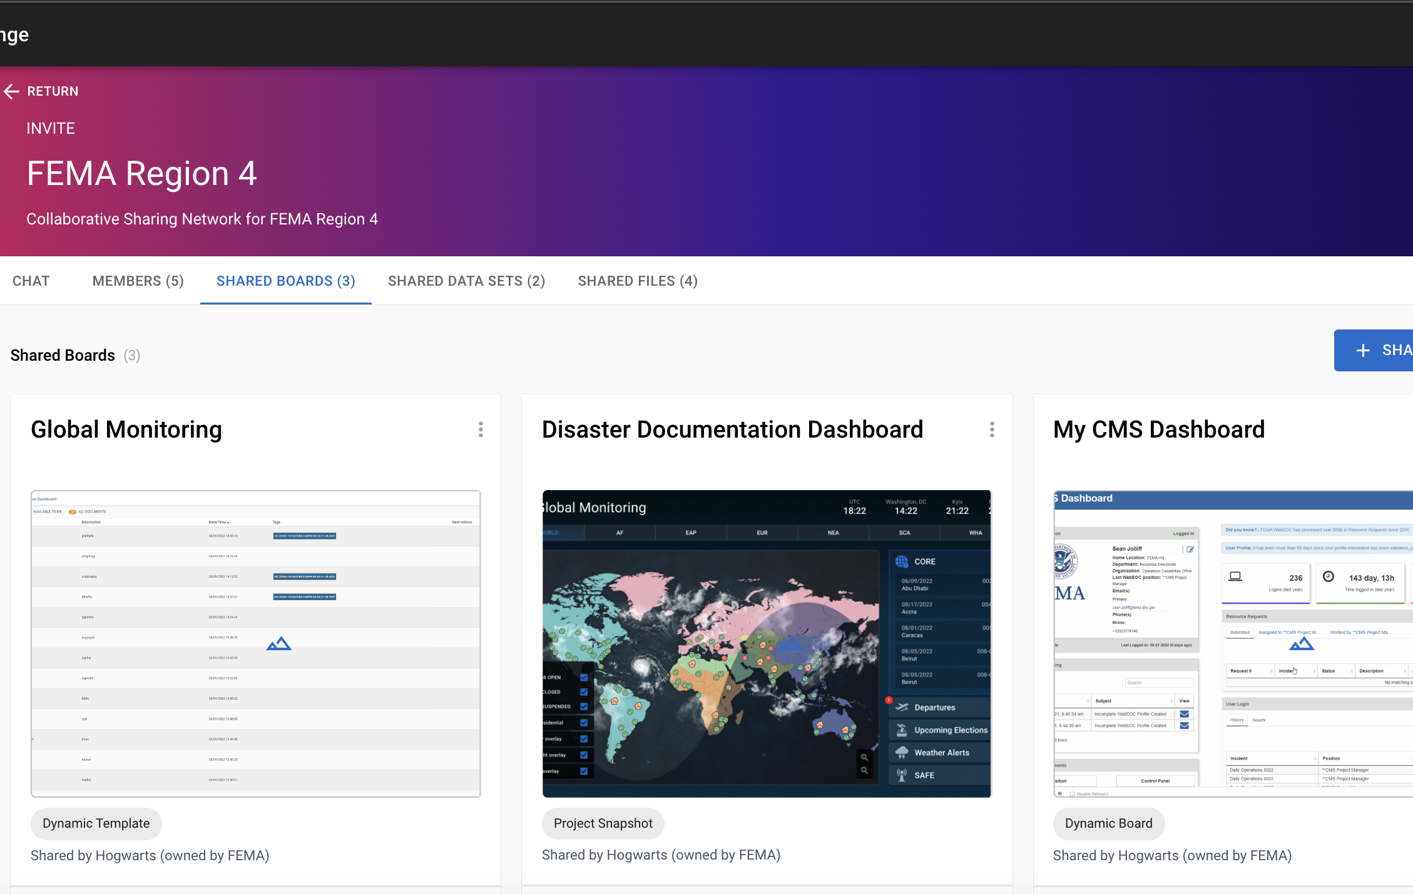
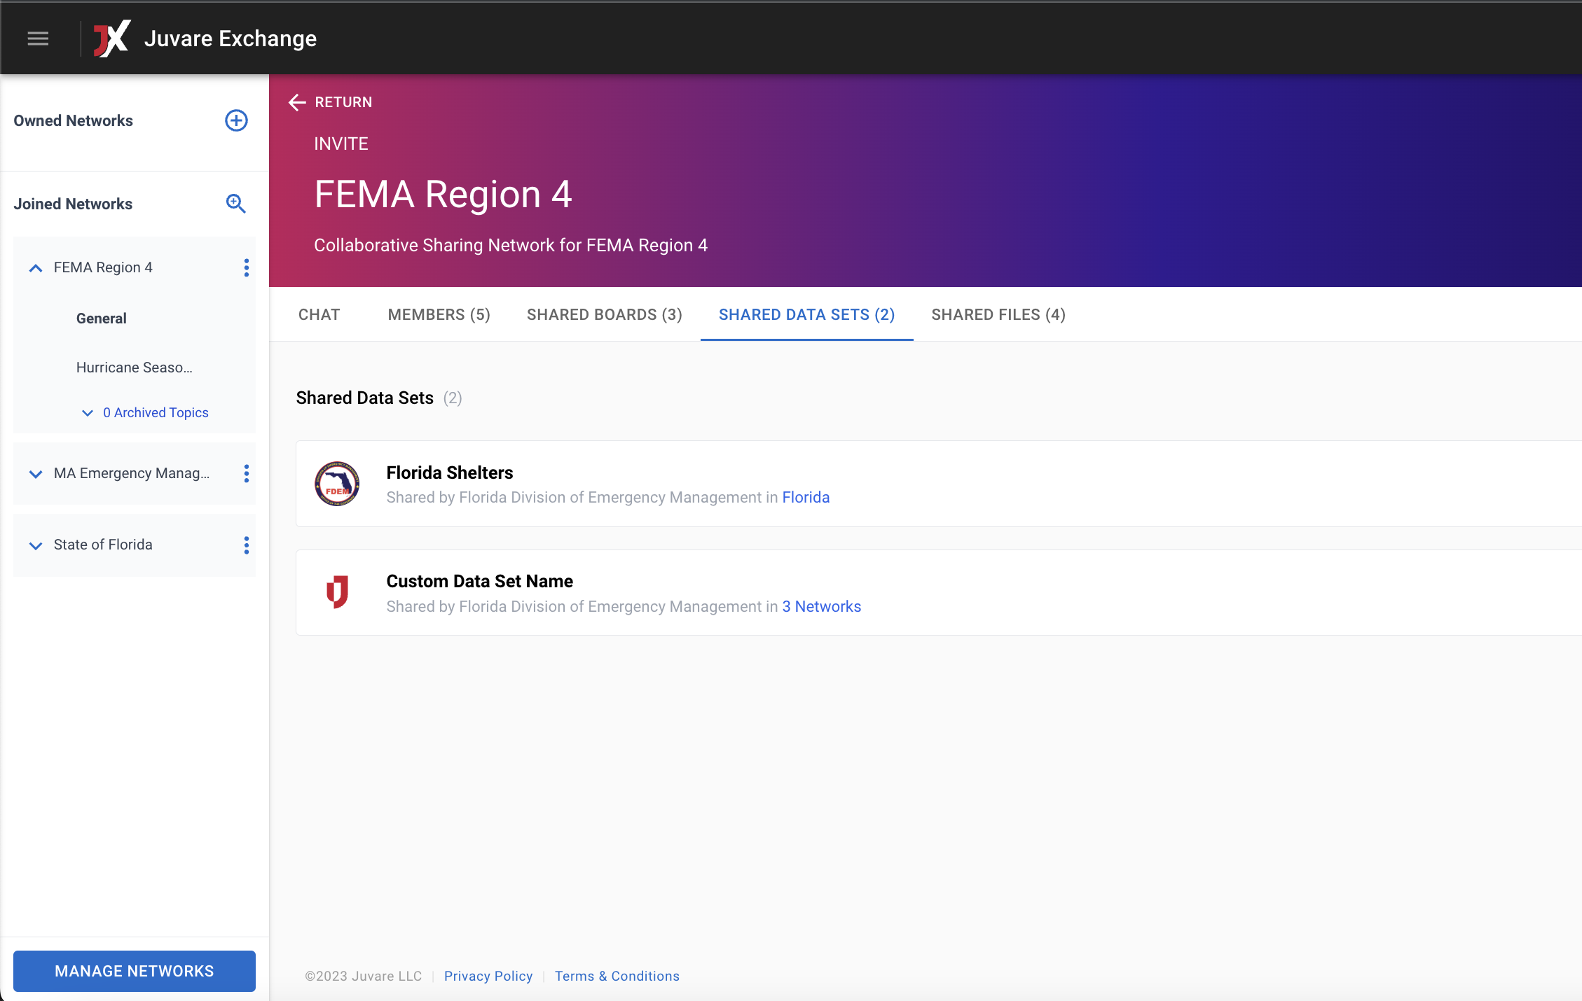
JX Board & Data Sharing
For deep system-to-system integrations, JX Collaborate will support both board sharing and granular data sharing.
JX Board Sharing
JX Data Sharing

Slide 30
JX Connectors
How JX has made integrations easier than ever

Slide 31
JX Connectors
What is a Connector, and how do they help in centralizing data?
JX Connector is Juvare’s new Integration as a Service product.
A cloud-based solution that automates the flow of data into and out of Juvare solutions.
It is a major component of the Juvare Exchange platform

Slide 32
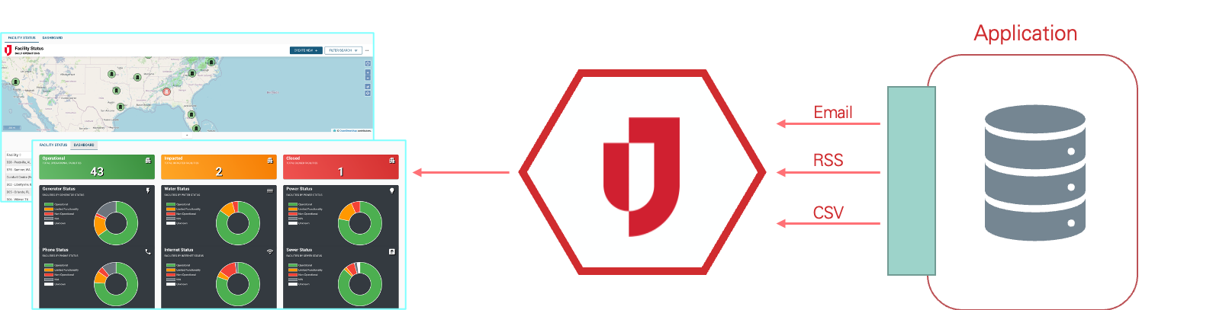

JX Standard Connectors
What is a Connector, and how do they help in centralizing data?

Slide 33
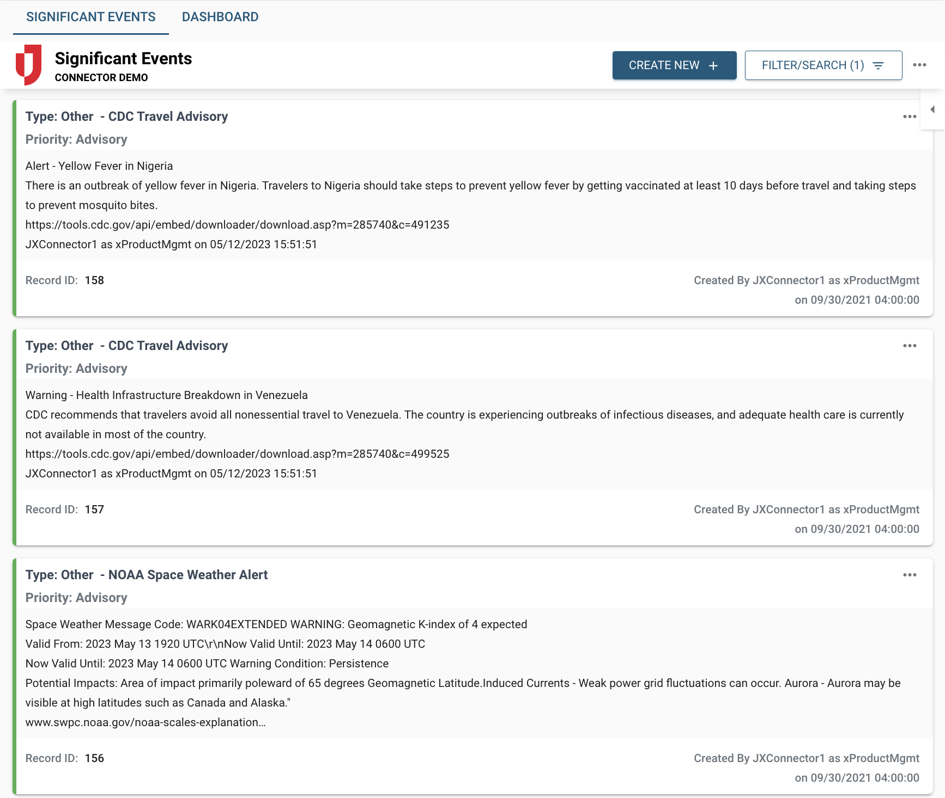

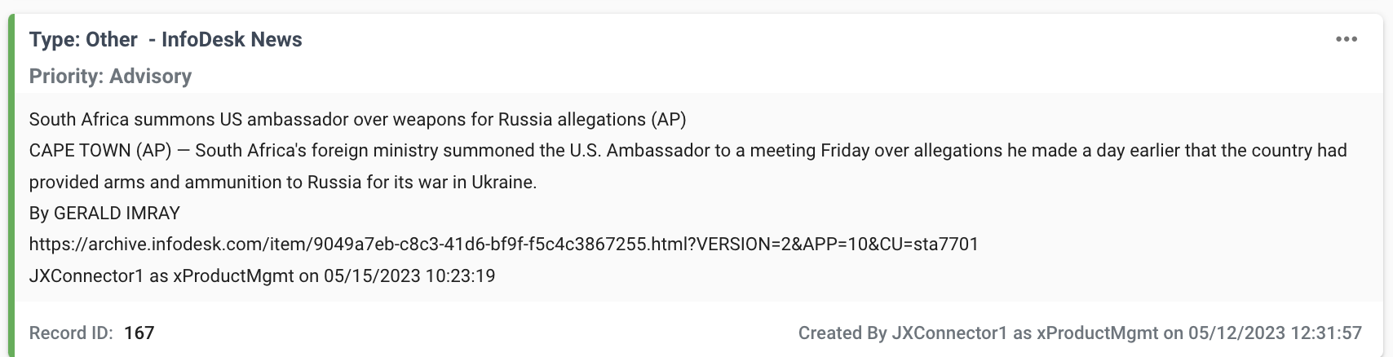




Juvare Exchange
Data Source
JX Connector

Slide 34
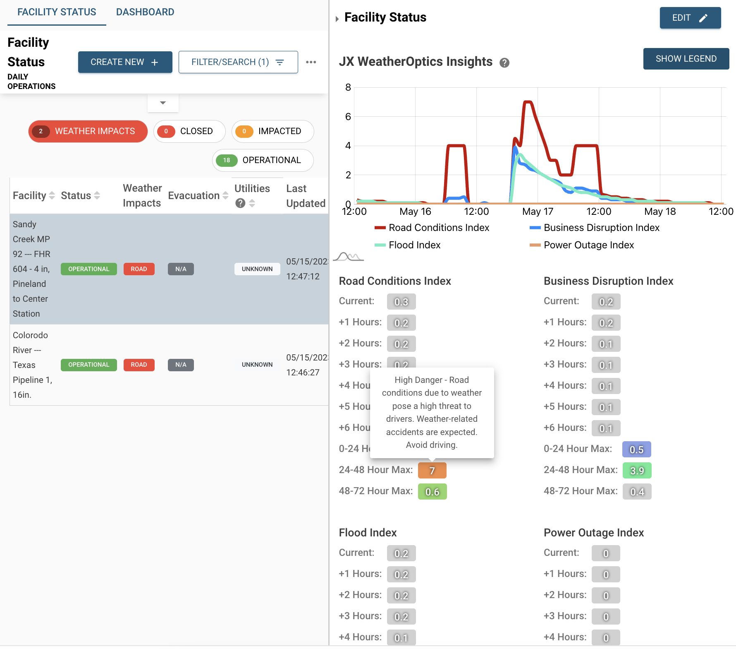

Juvare Exchange - Weatheroptics
Data Source
JX Connector

Slide 35
JX Analyze
How JX has made your data more insightful

Slide 36

JX Analyze – Our Vision
  JX Analyze offers deep business insights by leveraging Juvare’s domain expertise, anonymized data, and third-party data sources to support intelligent decisions.
750+
Juvare Clients
400+
WebEOC Clients
65+
EMResource Clients
20+
3rd Party Data Sources

Slide 37




What is JX Analyze?
What
Who
JX Analyze empowers Juvare clients with business insights based on historical trends and statistical analysis to support decision making
Juvare Clients
Why
Timeline
Ready to User Dashboards & Reports
Ad hoc Analysis
Ease of Interpreting data
EMResource NHSN Data Reporting – Beta Q2, 2023
WebEOC Standard Boards Beta – Q3, 2023

Slide 38
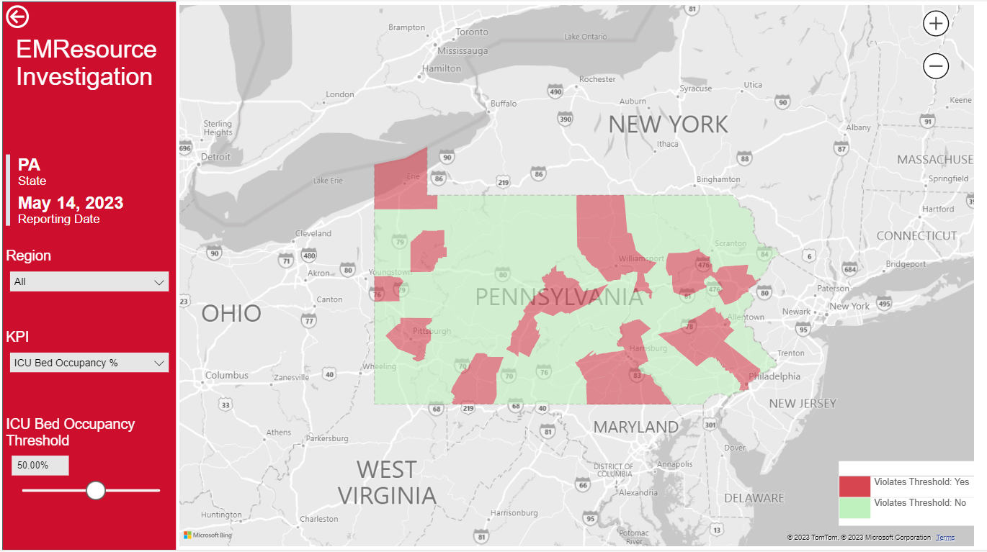
EMResource Investigation
Goal:
Report helps in identifying the hot button areas/Counties for the below KPIs
KPIs:
ICU Bed Occupancy %
Inpatient Bed Occupancy %
Pediatric Patient Bed Occupancy %
Detailed Reports:
Historical Trending
Hospital Details

Slide 39
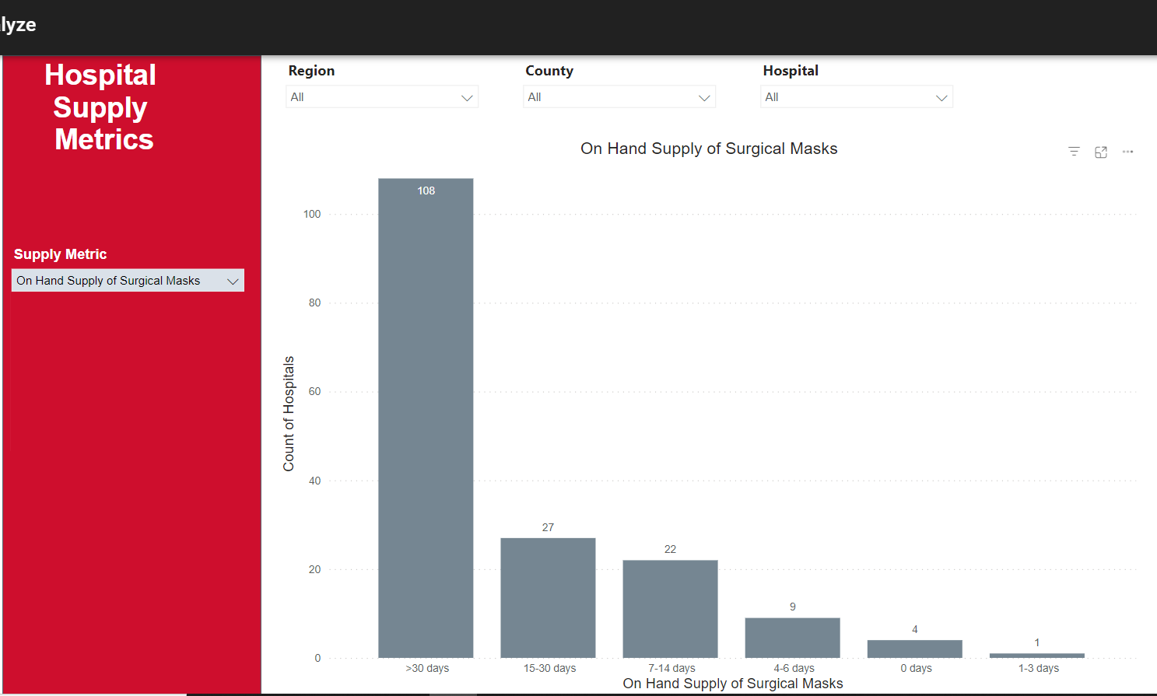
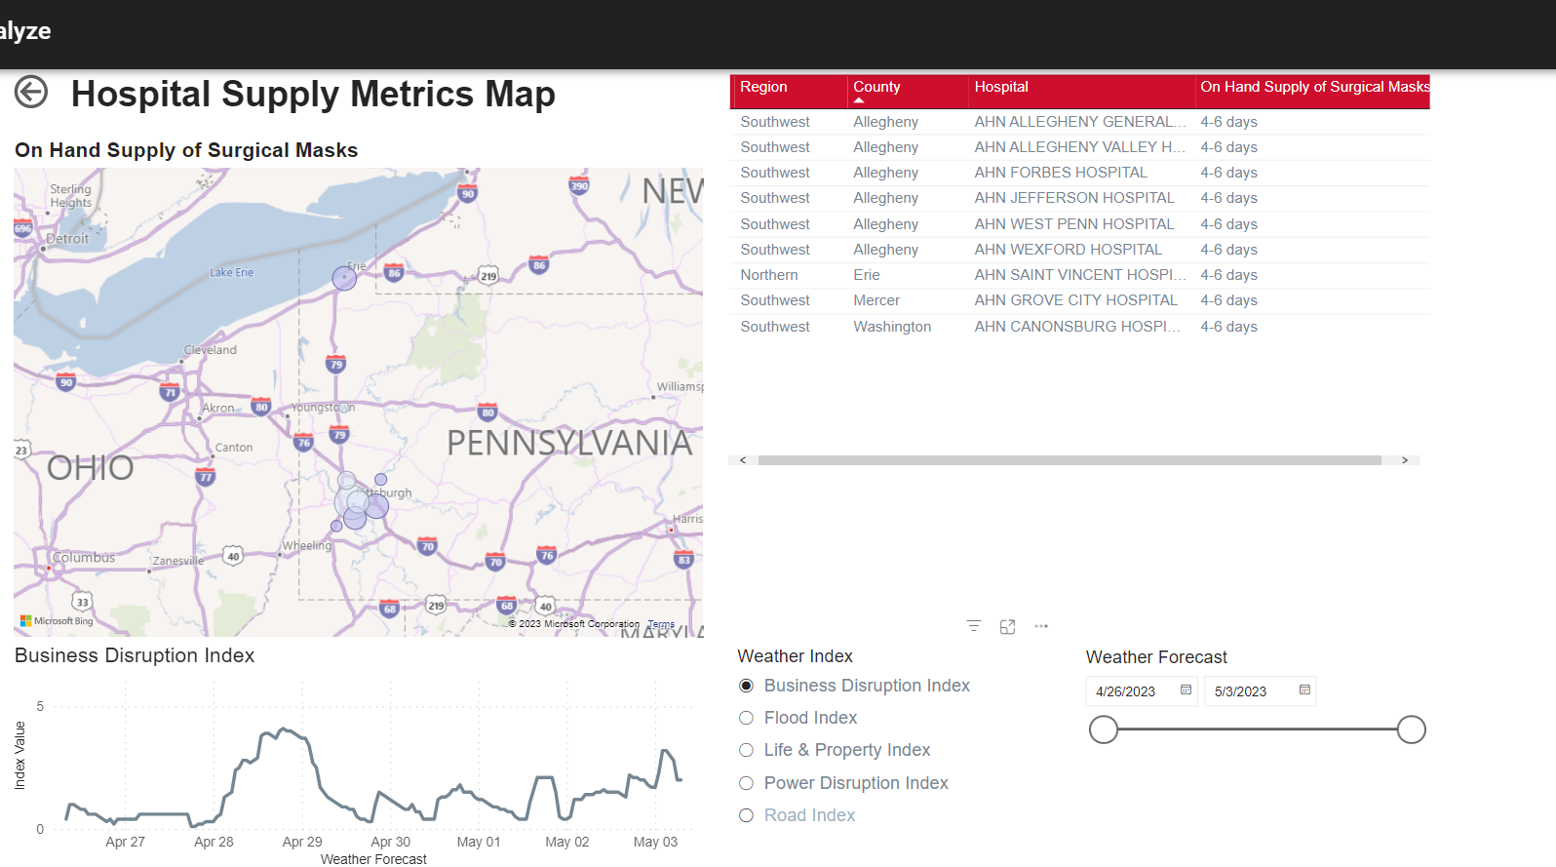
EMResource Supply Metrics
Goal:
Helps in monitoring the various Supply level KPIs for different Counties and Hospitals
KPIs:
On Hand Supply of Surgical Masks
On Hand Supply of N95 Aspirators
On Hand Supply of Gloves
On Hand Supply of Eye Protection
On Hand Supply of Surgical Gowns
Detailed Reports:
Hospital Supply Metrics Map

Slide 40
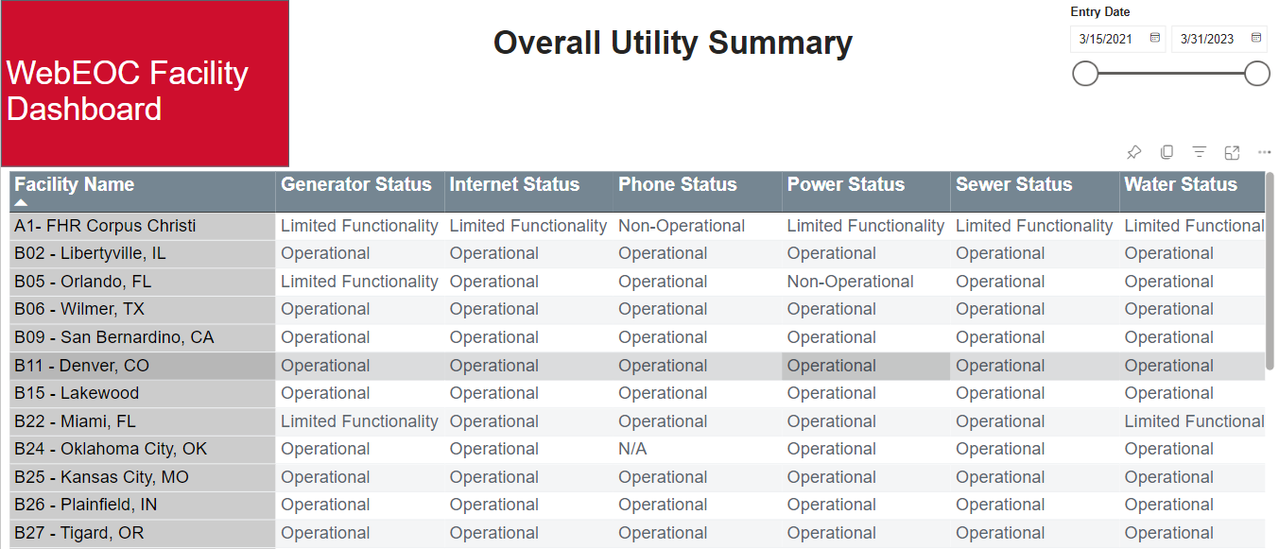
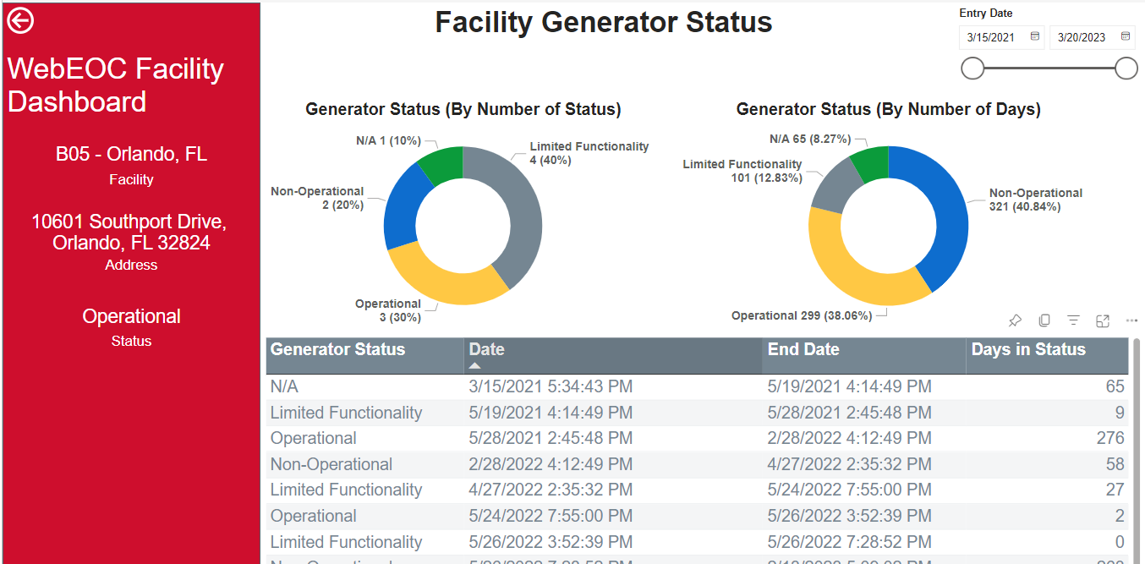
WebEOC – Facility Utilities Reporting
Goal:
Helps in monitoring the Facility Utilities, their status and historical information.

Slide 41



In Summary
JX Analyze will enable
  Historical Trends
  Ad hoc Analysis
  Improved Visualizations
  Ease of Data Interpretation
  Predictive Analytics

Slide 42
Thank you
42

